Slide 1
Formulating research: Aim and variables
AEPSY Year 11 Psychology

Slide 2
Review
List the three Rs of animal ethics
Explain the difference between confidentiality and privacy with regard to ethics of human research.

Slide 3
Learning Intentions
Formulating research
identify the aim/s of the research
develop a research question based on the aim/s
identify variables – independent, dependent, control, extraneous

Slide 4
Success Criteria
Identify aims for case studies
State aims as questions for research
Define independent, dependent, controlled and extraneous variables, giving examples

Slide 5
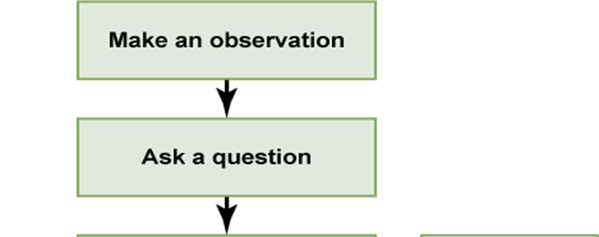
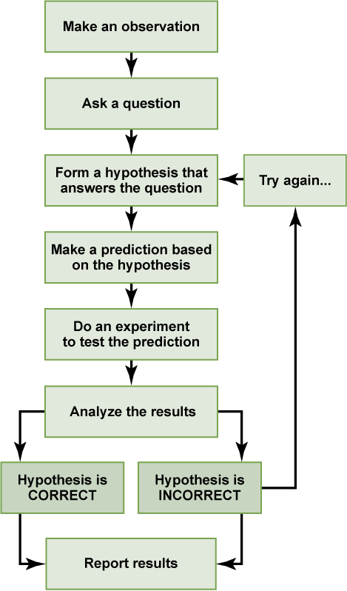
Scientific method

Slide 6
Aim
Identify the research issue or problem to be solved.
Develop a research question based on the aim.

Slide 7
Variables
List all variables that may relate to the research question, then determine which is to be manipulated (independent) to see its effect (dependent), and others which could potentially affect the outcomes (extraneous). A well designed experiment will have all the extraneous variables controlled.

Slide 8
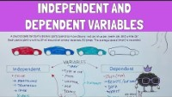

Slide 9
https://helpfulprofessor.com/psychology-experiments-and-case-studies/

Slide 10


Slide 11
Success Criteria
Identify aims for case studies
State aims as questions for research
Define independent, dependent, controlled and extraneous variables, giving examples

